Slide 1

CARDINAL HUME CATHOLIC SCHOOL
Y13 PARENT INFORMATION EVENT
2nd October 2025
Notes:
DGN

Slide 2
Aim of this event …………..
An insight into the final year at Cardinal Hume
01
Key dates and pressure points
02
Access to support
03
DGN
Notes:
DGN

Slide 3

WELCOME
THE SIXTH FORM TEAM :
Mr Gribbin - Assistant Headteacher
Mrs Ellender - Head of Yr 13
Dr. Shaw – Head of Yr 12
Miss Deverdics – Assistant Head of Yr 13
Mrs Clark – Assistant Head of Yr 12
Notes:
DGN

Slide 4

Notes:
DGN

Slide 5

Grades Explained
Target Grades
Predicted Grades
UCAS Grades
LER
Notes:
MSW

Slide 6

VISION….. equipping students with the right tools, experiences and skills to work out and realise their career goals
This Year
Unifrog account for each student which forms their own careers platform and work space
Independent Careers advice
Promotion of Progression Schemes on offer by numerous Universities
University experiences/Opening Days
Study Skills for academic success
LER
Notes:
LER

Slide 7

UCAS DEADLINES 2025
MEDICINE, DENTISTRY, VETERINARY SCIENCE, OXFORD, CAMBRIDGE: 15th OCTOBER 2025 18:00
All other courses : 12th December 2025
LER
Notes:
LER

Slide 8

The National Apprenticeship Show
3rd-4th February 2026
Vertu Motors Arena
LER

Slide 9
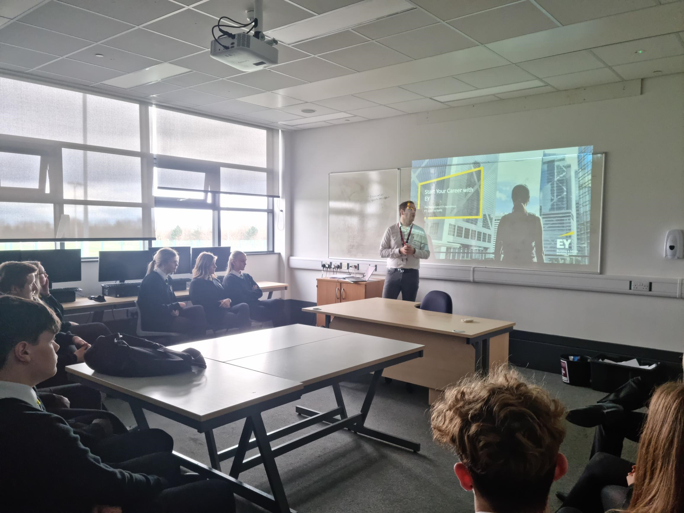
I.A.G. Opportunities to meet with Apprenticeship and Career representatives
LER

Slide 10
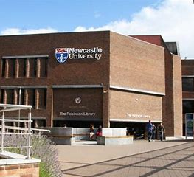
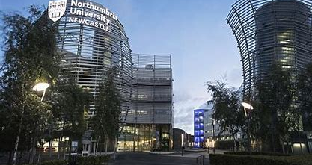


Destination Northumbria : APPLY BY MID JANUARY 2026
Newcastle Partners : APPLY BY MID JANUARY 2026
Newcastle Partners
First Choice Sunderland (Year 12)
Supported Progression - Durham (Year 12)
Notes:
LER

Slide 11
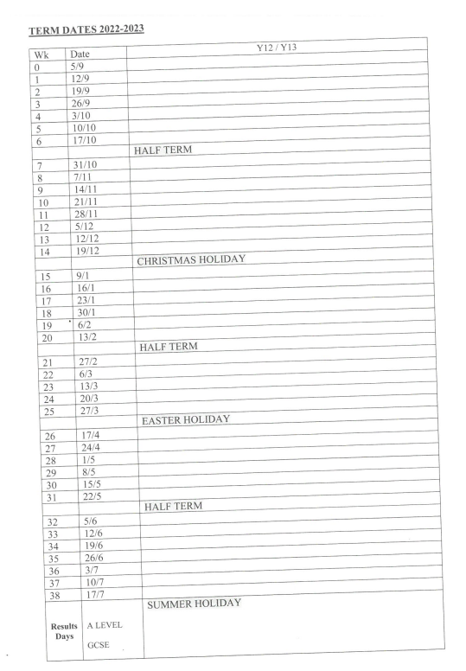
PRACTICE : Formal opportunities for students to apply their knowledge and skills in assessment situations that mimic the real external exams.
w/c | Focus
22nd Sept | Initial assessment
10th Nov | Modular Assessment 1
1st Dec | Vocational Mock Examinations
8th Dec | Assessment 1 Feedback + reports prepared
5th Jan | Vocational External Examinations
9th Feb | Y13 Mock exams
9th March | Year 13 RESITS (IF REQUIRED)
7th May | All Y13 vocational coursework completed by students
11th May – June 26th | Provisional Dates for External Examinations
LER
Notes:
MSW

Slide 12


After school study support
SDS
Notes:
DGN

Slide 13
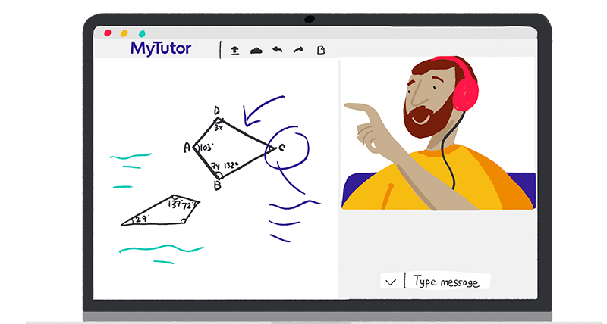

SDS

Slide 14
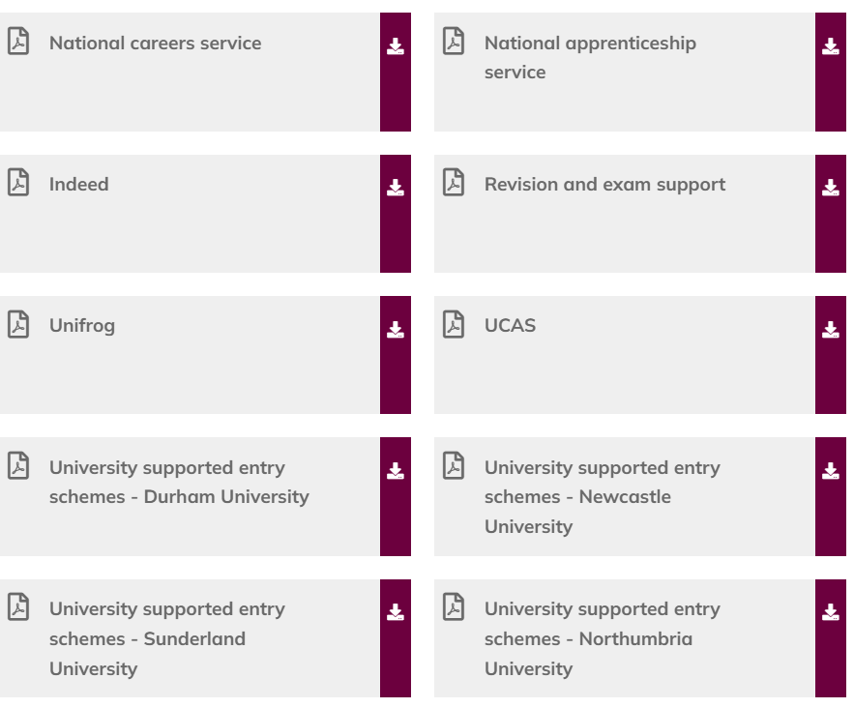
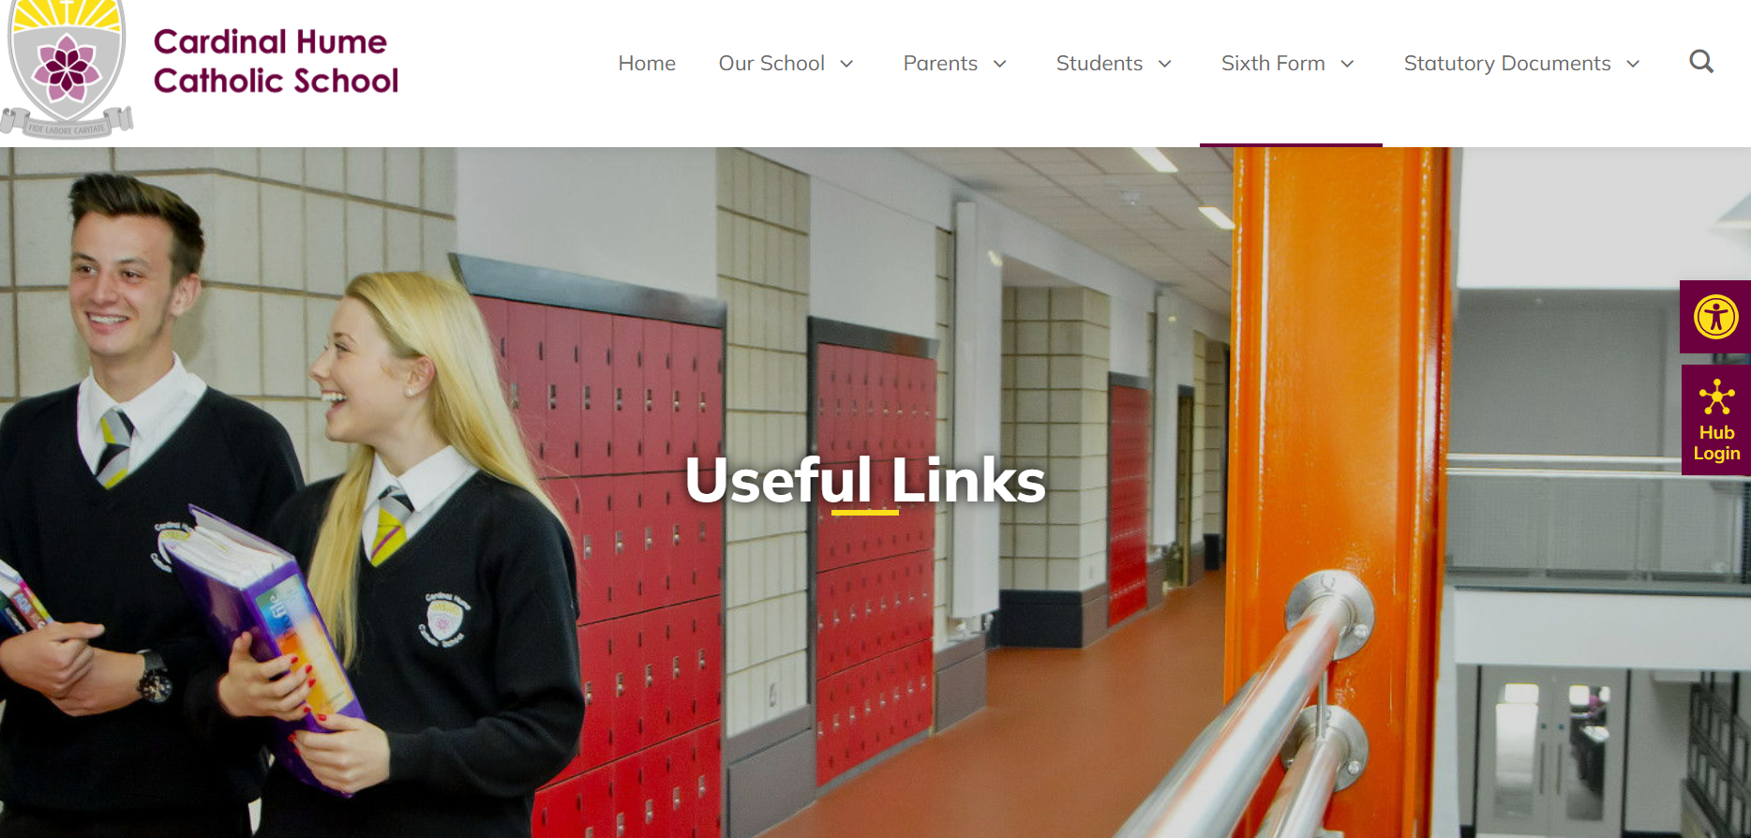
SDS
Notes:
LER

Slide 15
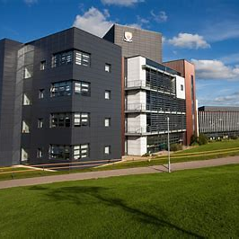
Year 13 Parents Evening – 25th November 2025
Year 13 Information Evening – 12th March 2026
DGN

Slide 16
Sixth Form Enrichment Activities
Sixth Form students can now request an hour of enrichment activity outside school each week, subject to meeting these conditions :
Being up to date with work; no academic issues raised on Sixth Form Monitoring.
Parental permission should be granted for a specified period of time so that if issues with work etc arise, the arrangement will not continue
Activity needs to have a clear focus and benefit for the student. Driving lessons are permitted.
This can be any period of Directed Study but we would encourage Enrichment during Period 6 as the most convenient.
Enrichment Activities cannot occur during IAG (2.05-2.50pm) on a Friday.
Student applications need to be supported by appropriate evidence, for example appointment cards, emails or direct knowledge of the activity proposed.
DGN

Slide 17

DGN

Slide 18

Year 13 Retreat 20st-22nd October

Slide 19
BURSARY (school)
Application for support can be made for students from the following defined groups :
1. To Vulnerable Young People, a fixed annual sum of up to £1200 per academic year can be paid. This is subject to students being able to prove that they meet the criteria for one of the following –
  Students are a looked after person (in care)
  Students are a Care Leaver
  Students are in receipt of Income Support
  Students are disabled and in receipt of Employment Support Allowance and Disability Living Allowance
2. Discretionary payments made to students who are eligible for Free School Meals during the school year 2025-2026.
3. Discretionary payments to students who are not eligible for free school meals but have a total family income up to but not over £25000 per year.
Notes:
DGN

Slide 20

What are Student Loans?
Funds loaned to you by the government, to help you cover the costs of going to university.
There are two types of loan:
A Tuition Fee Loan - paid to your university to cover the costs of your tuition
A Maintenance Loan - paid to you to help with living costs - like rent, bills, books and socialising
These loans are very different to commercial loans offered by banks. They are designed to make sure your repayments don’t start until a year after you’ve graduated, and are always manageable and affordable.
Notes:
DGN

Slide 21

Plan 5
How do Student Loans work?
Once you’ve decided to study a higher education course, you can apply for a Tuition Fee Loan of up to £9,250 per year to cover the cost of your course fees.
You apply through Student Finance England and the money is paid directly to your chosen university or college, so you don’t need to worry about making any payments yourself.
You won’t need to pay anything back –
  Until you've left university or college
    and
  Until you start earning over £25,000 per year.
Notes:
DGN

Slide 22

Rent, books, food and socialising are all a big part of university life - and they all cost money.
The government also provides a maintenance – or living costs - loan that is designed to help towards your living costs.
The amount of support you can access for living costs depends on your circumstances, including your household income and where you live and study.
Once you have applied for the loan, it’s paid into your bank account in three instalments - then it’s up to you to plan your budget and be smart about spending!
Notes:
DGN

Slide 23

BURSARIES & SCHOLARSHIPS
Many universities and colleges offer financial support to their students
through bursaries and scholarships.
Bursaries:
linked to personal circumstances and often, household income
awards can include fee waivers or cash
Scholarships:
can be linked to academic results or outstanding ability in an area
such as sport, music or art
can be subject specific and are limited in numbers
DGN

