Slide 1

CARDINAL HUME CATHOLIC SCHOOL Y12 PARENT INFORMATION EVENT
2nd October 2025
Notes:
Welcome to this Information event for parents of Y12 students.
This presentation is pre-recorded with notes to accompany each slide.

Slide 2
Aim of this event …………..
An insight into the two-year journey for students at Cardinal Hume Sixth Form
01
Key dates and pressure points
02
Access to support
03
Notes:
DGN

Slide 3

WELCOME
THE SIXTH FORM TEAM :
Mr Gribbin - Assistant Headteacher
Mrs Ellender - Head of Yr 13
Dr. Shaw – Head of Yr 12
Miss Deverdics – Assistant Head of Yr 13
Mrs Clark – Assistant Head of Yr 12
Notes:
DGN

Slide 4
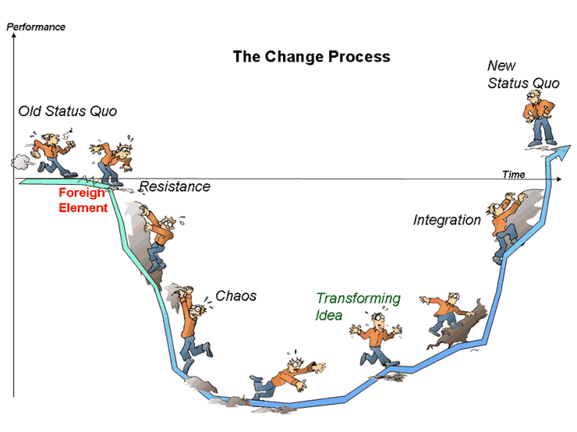
Notes:
DGN

Slide 5
DGN
A LEVEL GRADE | BTEC Level 3 EXTENDED CERTIFICATE (V1=1 A LEVEL) | BTEC Level 3 DIPLOMA (V2= 2 A LEVELS) | Cambridge Technical Level 3 EXTENDED CERTIFICATE (V1=1 A LEVEL) | Cambridge Technical Level 3 DIPLOMA (V2= 2 A LEVELS) | UCAS POINTS
 |  | D*D* |  | D*D* | 112
 |  | D*D |  | D*D | 104
 |  | DD |  | DD | 96
 |  | DM |  | DM | 80
 |  | MM |  | MM | 64
A* | DISTINCTION * |  | DISTINCTION * |  | 56
A | DISTINCTION | MP | DISTINCTION | MP | 48
B |  |  |  |  | 40
C | MERIT | PP | MERIT | PP | 32
D |  |  |  |  | 24
E | PASS |  | PASS |  | 16

Slide 6
A level Courses
DGN
LINEAR – final grade is decided at the end of 2 years in the external summer exam
EXAM PAPERS – different numbers for different subjects, topics and skills to be assessed in each paper clearly outlined in the subject SPECIFICATION ( Syllabus)
INCREASE IN COMPLEXITY FROM Y11>Y12>Y13
LEARN > DEMONSTRATE > APPLY > SYNTHESISE
GRADING :
A*
A
B
C
D
E ALL a PASS AT A LEVEL

Slide 7
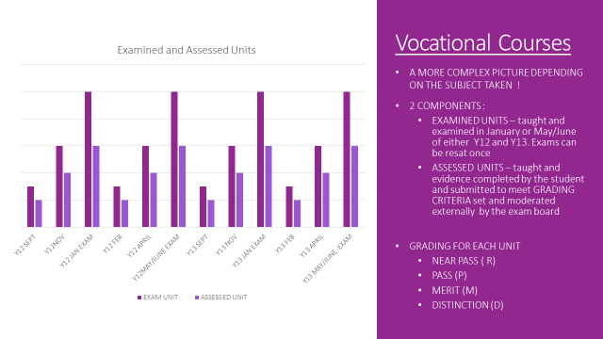

Slide 8
Y12 VOCATIONAL EXAMS by SUBJECT
SUBJECT | JANUARY EXAM Y12 | MAY/JUNE EXAM Y12 | JANUARY EXAM Y13 | MAY/JUNE EXAM Y13
V1 SCIENCE |  | UNIT 1 |  | UNIT 3
V1 SPORT | UNIT 1 | UNIT 3
V1 BUSINESS |  | UNIT 1 | UNIT 2
V1 HEALTH + SOCIAL CARE |  | UNIT 4 + 2 | UNIT 3

Slide 9
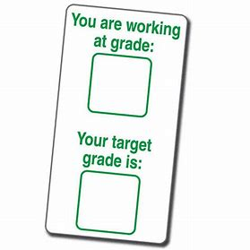
VISION
TARGET GRADES EXPLAINED
Target Grades are calculated using your own GCSE results from KS4
Your grades are added up and an Average GCSE score calculated :
Average GCSE Score = Total Points / Number of GCSE’s
Your Average GCSE score is compared nationally across the country to students who previously had the same Average GCSE Score and what they actually achieved at the end of Sixth Form
Your individual Target Grade for each subject is then produced
Notes:
MSW

Slide 10
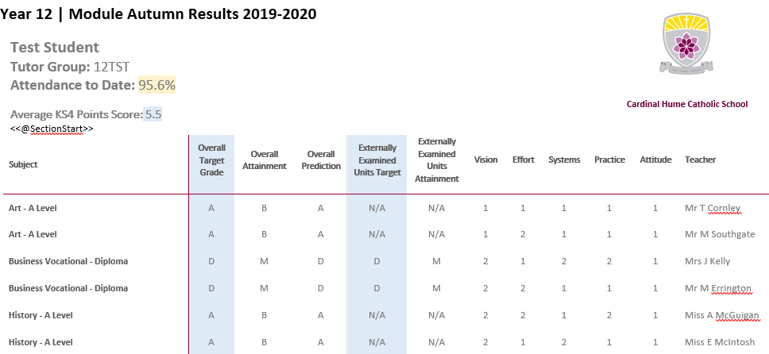

Slide 11
VESPA REPORT GRADES…....a 2 means they are doing everything asked of them:
VESPA | Vision | Effort | Systems | Practice | Attitude
Grade Description | Purpose, direction, awareness of progression opportunities + value of study | Time spent on study | Organisation of Work | Effectiveness of revision and learning Strategies | Determination, resilience + self-direction
1 | Able to communicate an enthusiasm for and enjoyment of the subject and wishing to study it further or use it to help progress to the next stage of education or employment | Goes beyond the requirement for number of hours of study where necessary, ensuring that sufficient time is given to study to produce excellent results | Exemplary organisation of all resources enables easy reference to notes, past papers, independent study work and other materials | Carefully chosen and appropriate strategies are used to ensure learning and revision are effective. | Self-directed and motivated, using mistakes as an opportunity for learning. Resilient and determined.
2 | A clear awareness of the purpose of study, both in terms of future progression and value in the subject itself | Meets the requirement for the number of hours of independent study. | Well organised folders and notes are a good resource for revision. Past papers, independent study work and other resources are arranged in a manner which helps learning and revision. | A range of learning strategies are evident, such as mind maps, condensing notes, past paper examples and post it notes. Evidence is available to show that these are effective. | A positive attitude and desire to succeed.
3 | Yet to develop a clear idea of value and purpose for studying the subject | Does not yet commit sufficient time to study | Folders, notes, revision resources and independent study materials are not always organised to enable best use to be made of them. | A limited range of learning strategies is used which may prevent expected progress. | Not yet positive and motivated. May be reluctant to acknowledge connection between own approach and success.
ABS
Notes:
So the KS5 Mindset simplifies to VESPA
And every assessment includes a grade for each of the 5 elements of this.
A grade 2 means that a student is doing well and carrying out everything we ask of them to help them make steady progress in their 2 year route through their sixth form courses.

Slide 12
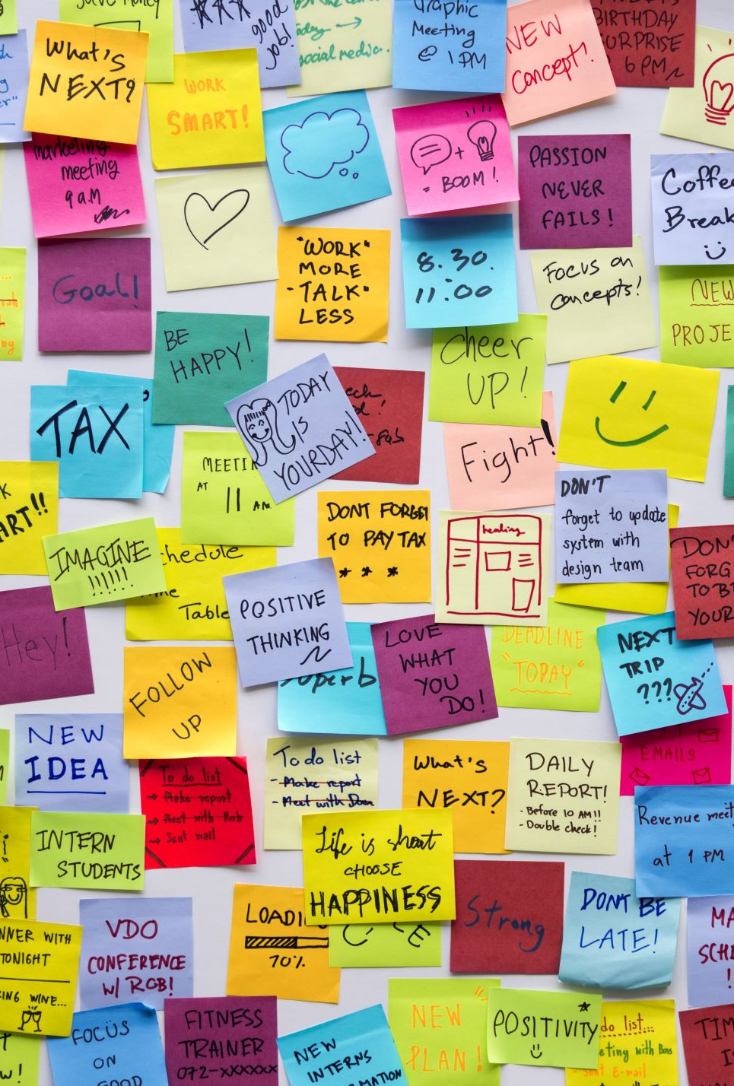
VISION….. equipping students with the right tools, experiences and skills to work out and realise their career goals
Unifrog account for each student which forms their own careers platform and workspace
Independent Careers advice in Year 13
Work Experience week September 1st - 4th 2026
Y12 Futures Week before the summer holiday 2026 to kick start applications for University and Apprenticeships
University experience days
Visits to Careers Fairs and Work places
Contact with Universities and Apprenticeship groups
Study Skills for academic success
Notes:
LER

Slide 13
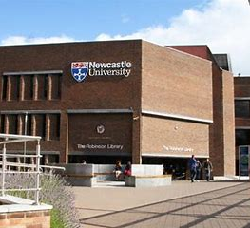
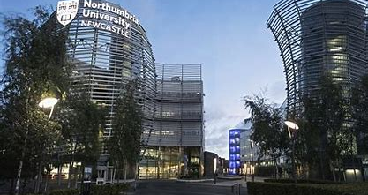


Destination Northumbria : (Year 13)
Newcastle Partners : (Year 13)
Newcastle Partners
First Choice Sunderland (Year 12)
Supported Progression - Durham (Year 12)
ABS
Notes:
LER

Slide 14
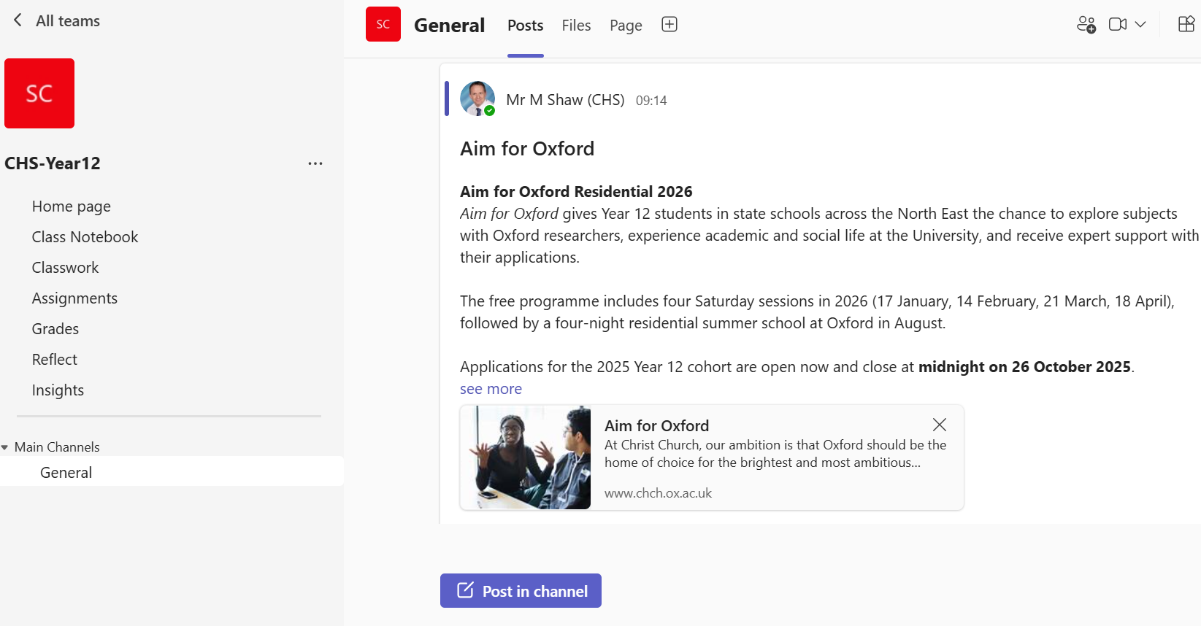
MSW

Slide 15
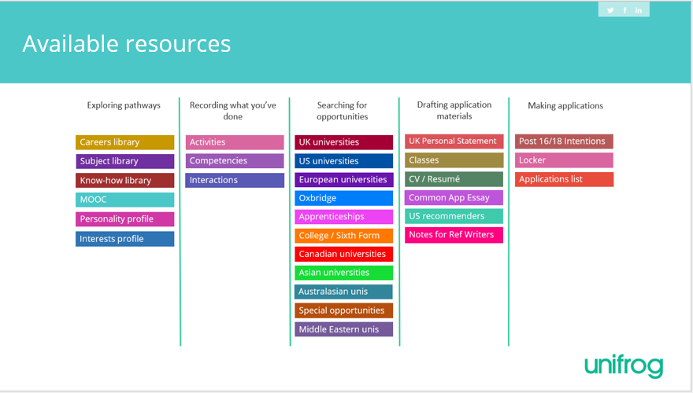
Available resources

Slide 16
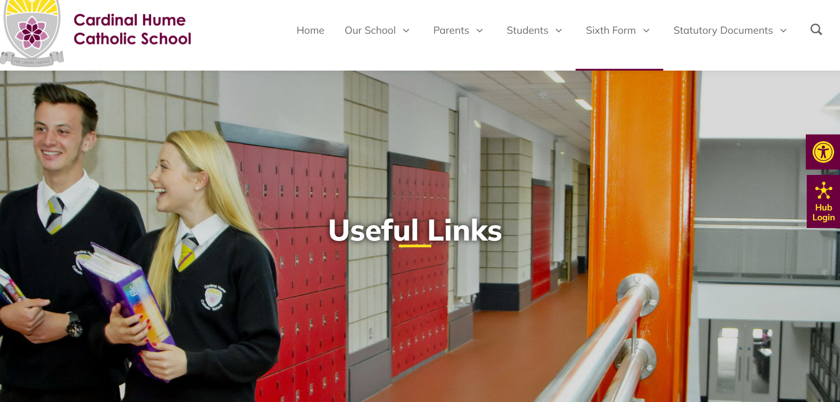
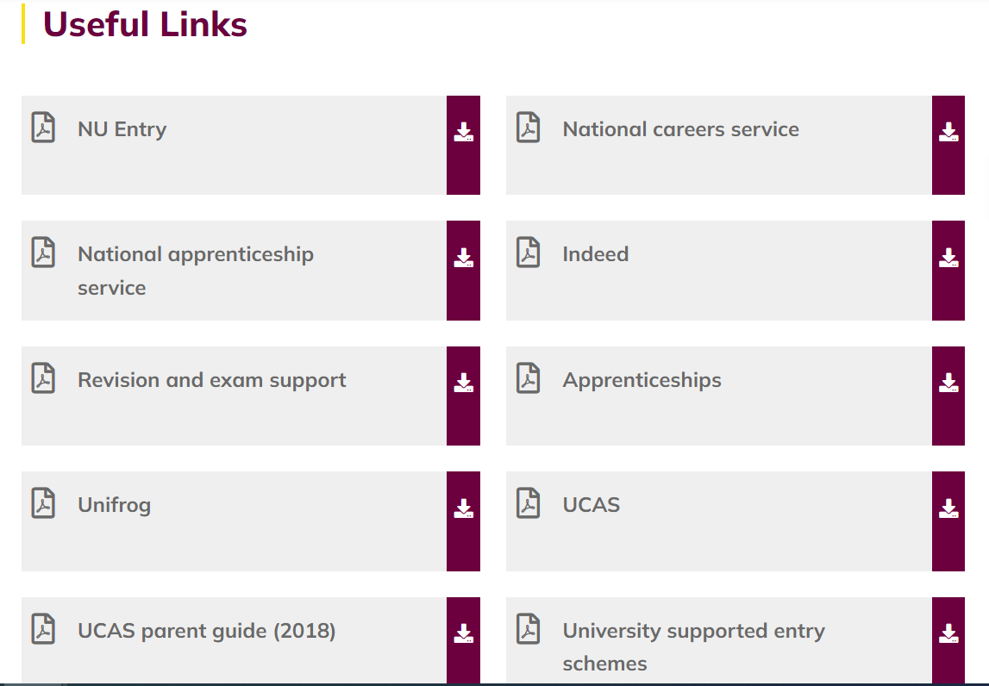
Notes:
LER

Slide 17
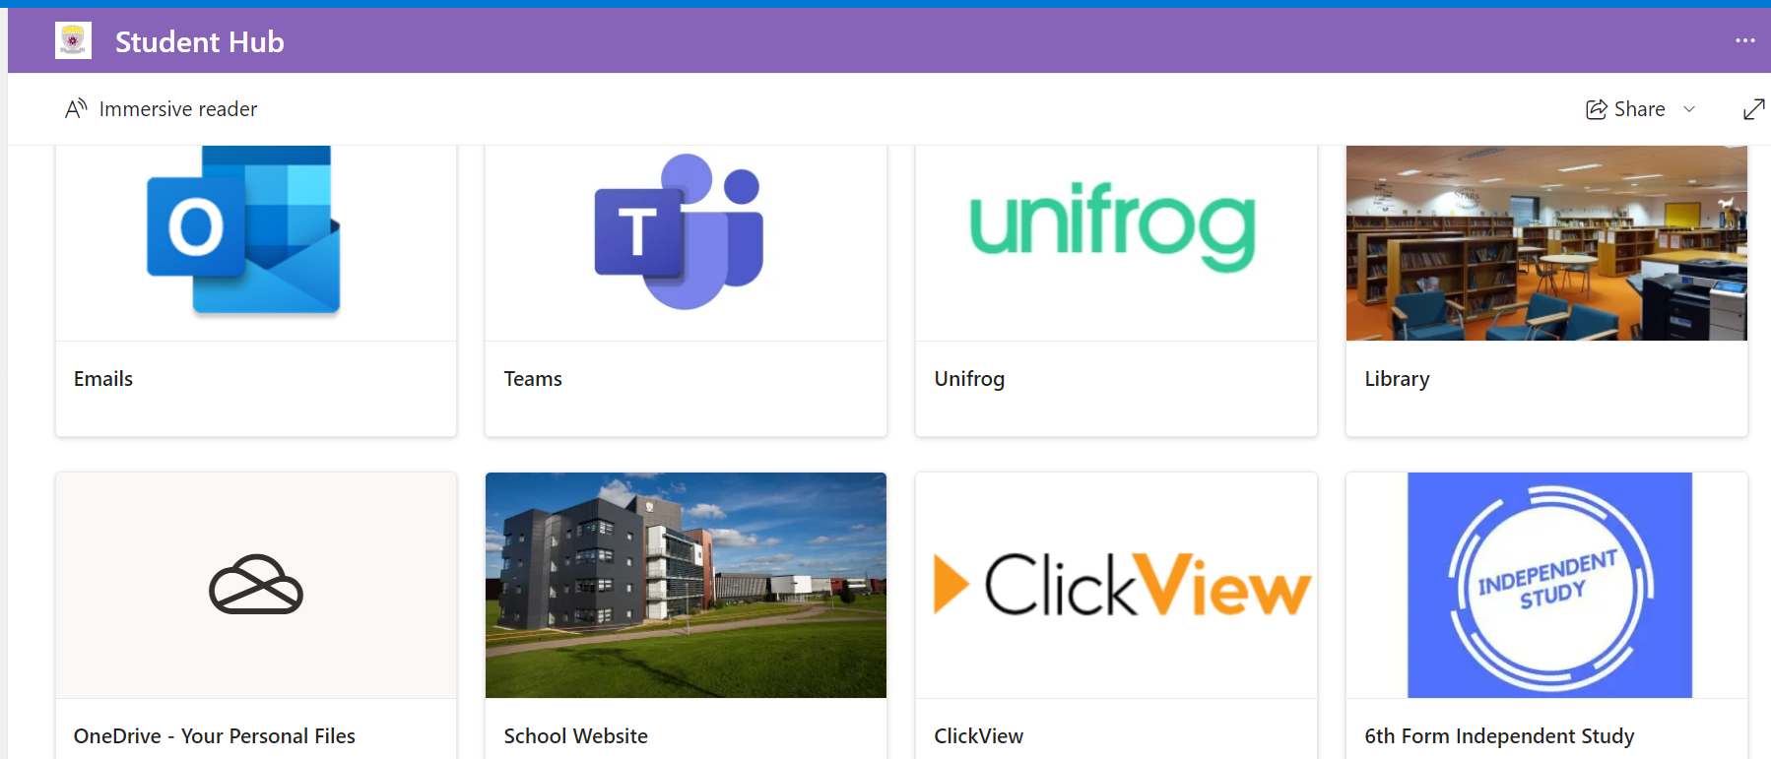
ABS
Notes:
LER

Slide 18
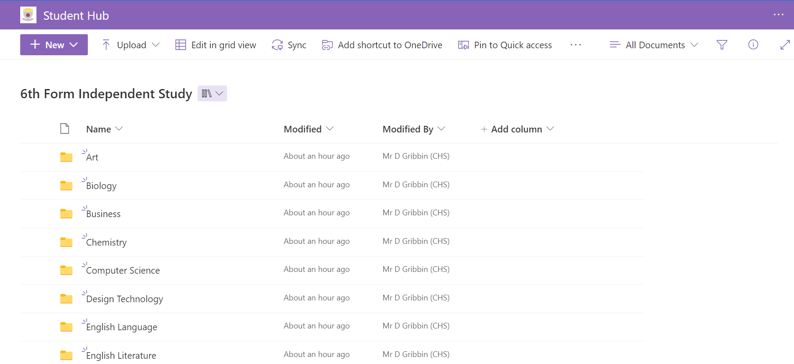
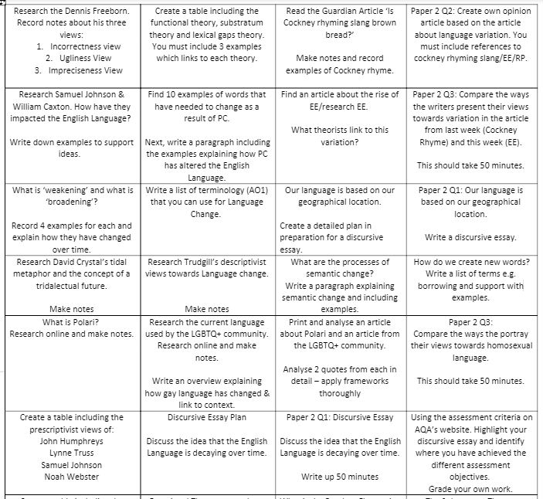
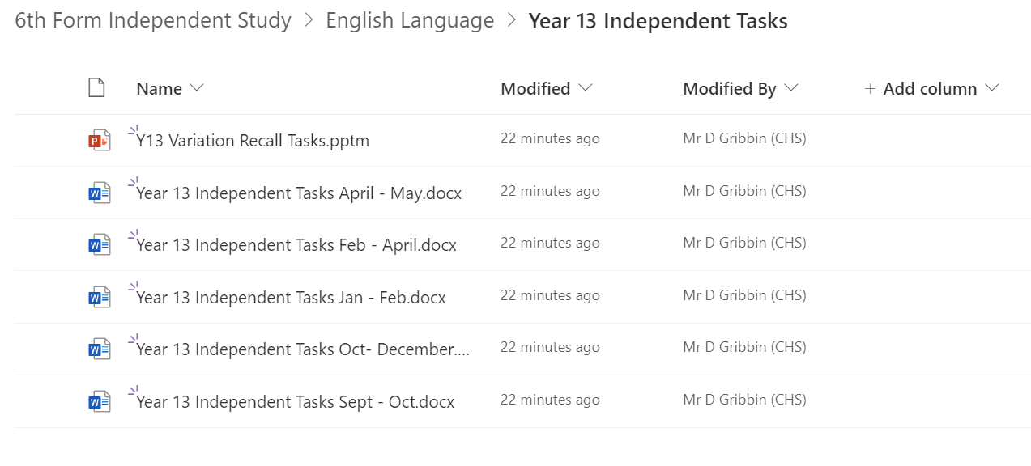
ABS
Notes:
LER

Slide 19
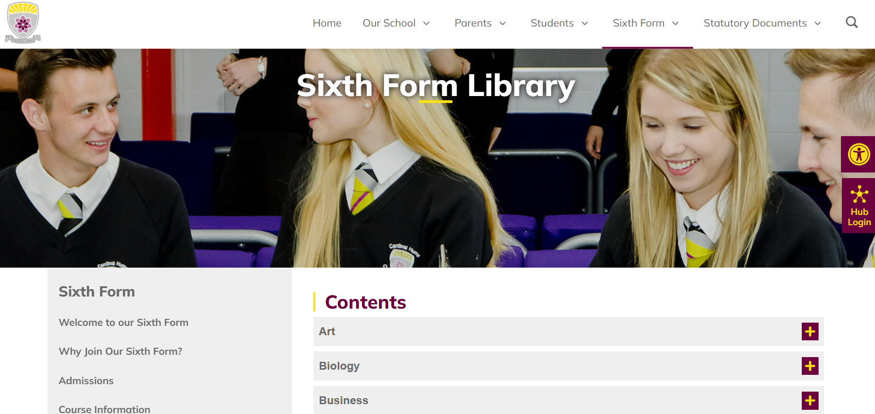
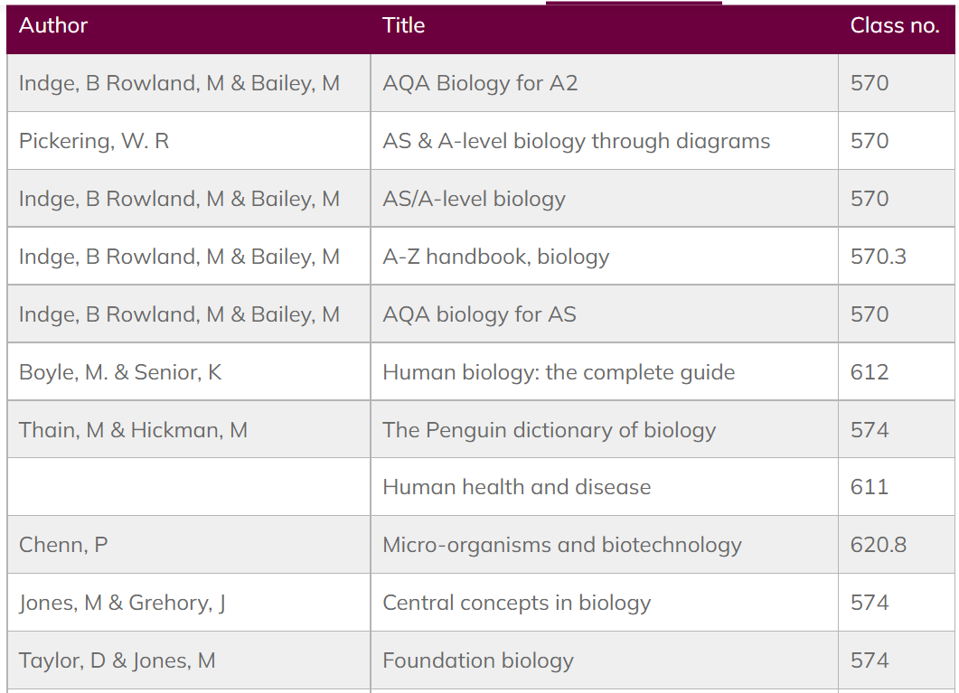
Notes:
LER

Slide 20
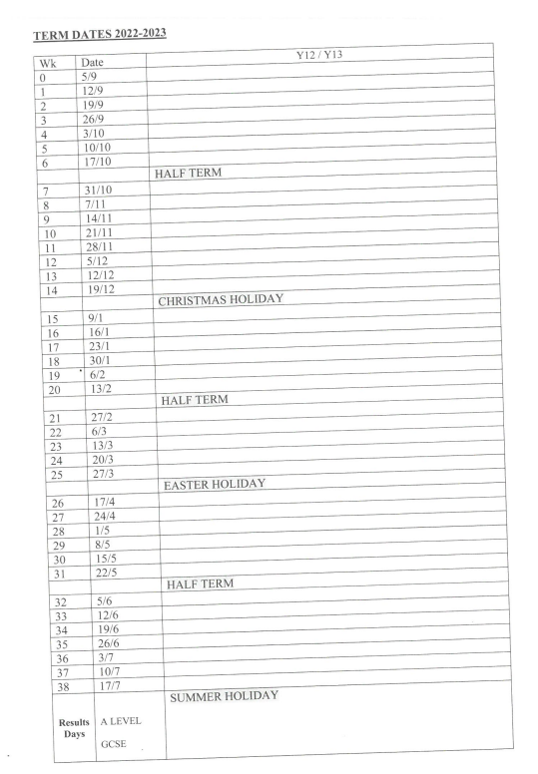
PRACTICE : Formal opportunities for students to apply their knowledge and skills in assessment situations that mimic the real external exams.
w/c | Focus
22nd Sept | Initial assessment
3rd Nov | GCSE Resit
10th Nov | Modular Assessment 1
1st Dec | Vocational Mock Examinations
8th Dec | Assessment 1 Feedback + reports prepared
5th Jan | Vocational External Examinations
9th Feb | Modular Assessment 2
11th May – 26th June | Provisional Dates for External Examinations
^{22nd June} | Mock exams
Notes:
MSW

Slide 21
Supportive Measures in Sixth Form
MONITORING by departments > scrutinised by Sixth Form staff
VESPA Service Plan : Meet with KS5 Mentor to plan a resolution to work or skills issue identified
Purple Report: Report to Head of Year for more specific issues ranging from formal monitoring of progress in 1 or more subjects to attendance, punctuality and behavioural incidents.
Pink Report: Reporting to Director of Post 16 when purple report has not resolved issues or for more serious incidents.
ABS
Notes:
Purple Report: Report to Mr Brookes for more specific issues ranging from formal monitoring of progress in1 or more subjects to attendance, punctuality and behavioural incidents.
Pink Report: Reporting to Mrs West when purple report has not resolved issues or for more serious incidents.

Slide 22
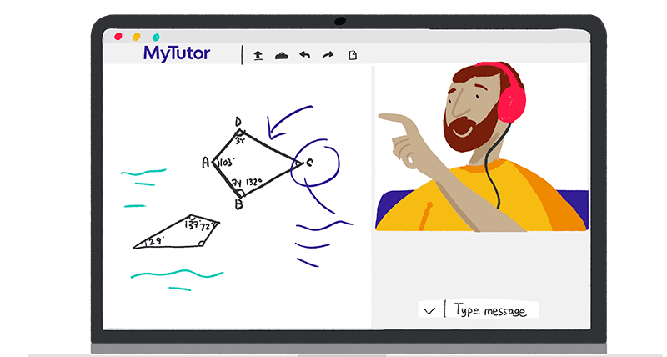
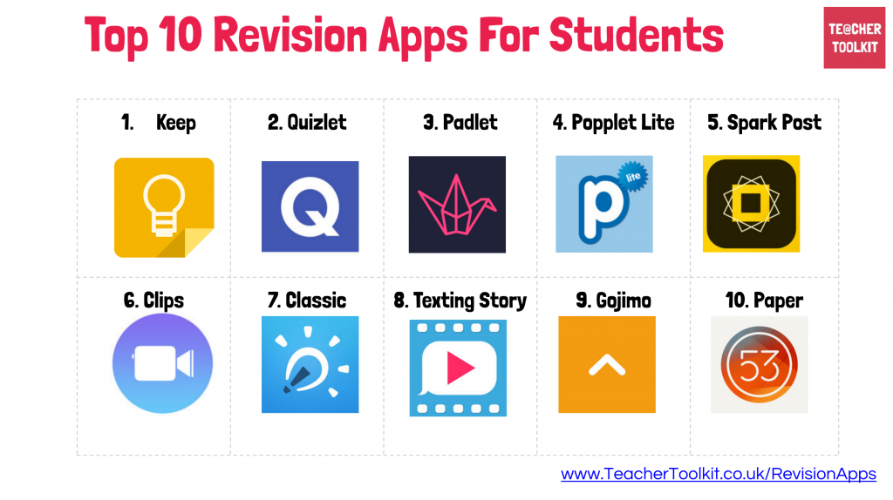

Slide 23
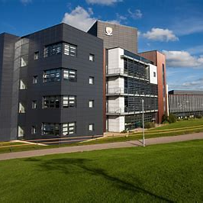
Year 12 Parents Evening – 17th March 2026
DGN

Slide 24
BURSARY
Application for support can be made for students from the following defined groups :
1. To Vulnerable Young People, a fixed annual sum of up to £1200 per academic year can be paid. This is subject to students being able to prove that they meet the criteria for one of the following –
Students are a looked after person (in care)
Students are a Care Leaver
Students are in receipt of Income Support
Students are disabled and in receipt of Employment Support Allowance and Disability Living Allowance
2. Discretionary payments made to students who are eligible for Free School Meals during the school year 2025-2026
3. Discretionary payments to students who are not eligible for free school meals but have a total family income up to but not over £25000 per year.
Notes:
DGN

Slide 25
Sixth Form Enrichment Activities
Sixth Form students can now request an hour of enrichment activity outside school each week, subject to meeting these conditions :
Being up to date with work; no academic issues raised on Sixth Form Monitoring.
Parental permission should be granted for a specified period of time so that if issues with work etc arise, the arrangement will not continue
Activity needs to have a clear focus and benefit for the student. Driving lessons are permitted.
This can be any period of Directed Study but we would encourage Enrichment during Period 6 as the most convenient.
Enrichment Activities cannot occur during IAG (2.05-2.50pm) on a Friday.
Student applications need to be supported by appropriate evidence, for example appointment cards, emails or direct knowledge of the activity proposed.
DGN

Slide 26

Year 12 School Walk
24th October

