Slide 1
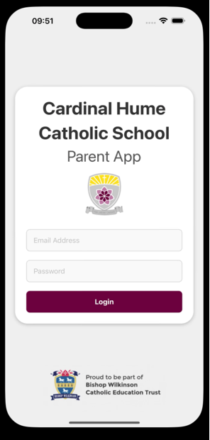
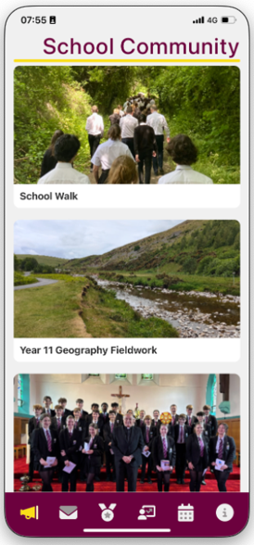

Cardinal Hume Parent APP
Launched to every year group
Use to report absences
Use to track your child’s attendance
Receive messages and key information
Tracking of House Points

Slide 2


We are now live on social media. Follow us for the latest updates and highlights from our school community.
Cardinal Hume Catholic School
@CardinalHumeCS

Slide 3


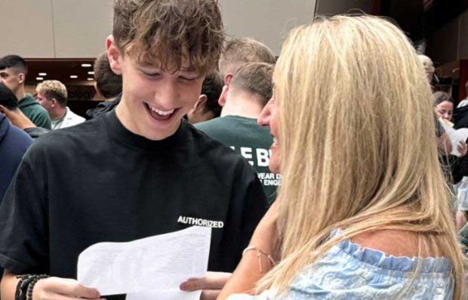
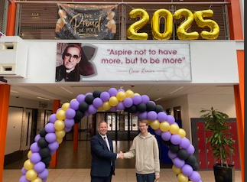
Year 11 at CHCS
Raising Achievement – Information for Parents

Slide 4
A Prayer Reflection
Let us make the sign of the cross together:
All: In the name of the Father, and of the Son and of the Holy Spirit Amen.
Lord, as we gather here tonight, let us think about how we can journey together as Cardinal Hume School Community.
We think of what this year may bring. It will bring times of work and play, experiences of success and challenge which are all part of school life. It is a new beginning, the planting of a seed that will grow for a year, the seed that will blossom in times to come. It offers new hope, hope for good work, for successful results, for friendships, for fun and for learning.
We offer it all to you today response
All: Be our help in the days to come

Slide 5
A Prayer Reflection
Lord, we ask that you speak into the hearts of all who are here tonight and may we receive your love and guidance as we embark on a journey of hope and faith together. May we be reminded that in all we do and say, you are with us and will guide us on the right path. Response
All: Be our help in the days to come.
Let us make the sign of the cross together:
All: In the name of the Father, and of the Son and of the Holy Spirit Amen.

Slide 6
Our Mission
The mission of Cardinal Hume Catholic School is founded on the teaching of Christ and seeks to fully develop each member of our community through faith, hard work and kindness.​

Slide 7








Slide 8
Aims this evening
Demonstrate to you how the staff at Cardinal Hume will help students maximise their potential
Outline the support that is offered to our students
Answer any questions you may have about the year ahead

Slide 9
Key Dates in Year 11
20th November 2025: Sixth Form Information Evening
24th November 2025: Revision materials provided
8th December 2025: MOCK EXAMS
5th January 2026: MOCK MFL Speaking exams
20th January 2026: Parents’ Evening
16th February 2026: Revision materials provided
9th March 2026: MOCK EXAMS
22nd and 23rd June 2026: Sixth Form Induction
20th August 2026: GCSE Results Day
4th May – 26th June 2026 GCSE EXAMS

Slide 10
Continued success at Cardinal Hume
Ofsted : Outstanding, May 2024
In Summer 2025, Cardinal Hume students achieved an excellent set of GCSE results
The average grade across all subjects was a 5+.
Over 33% of all results were graded at 7+
7.5% of all grades were grade 9 (the most grade 9s ever).

Slide 11
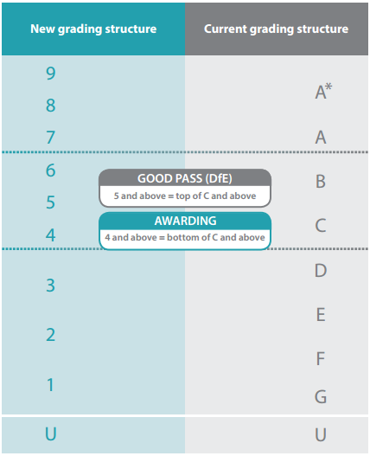
The 9-1 scale
4 is a standard pass
5 is a good pass
We would like many of our students to be aiming at grade 7 (grade A equivalent)
Grade 9 is achievable !
(CH 7.5% v 3.5% national)

Slide 12
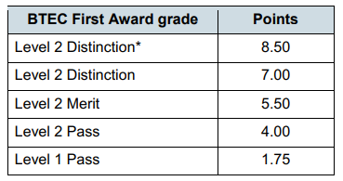
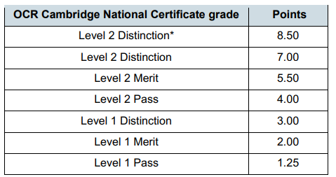
Vocational courses

Slide 13
The best chance of success
The majority of the examinations will come at the end of Year 11
On the GCSE pathway, approximately 25 exams
Thorough revision and practicing exam techniques will be vital
Most important – Excellent attendance, consistent effort and a positive attitude to school

Slide 14
Focus on Attendance
Student target : 97%
Current Y11 Attendance in Y10: 93.3%
Attendance so far this year: 95%
There is a clear correlation between attendance & academic success and therefore it is something we take extremely seriously
Absent for 8% of school =
15 days
75 lessons
This is difficult to catch-up.
Absent for 4% of school days
8 days
40 lessons
There will be gaps in knowledge.

Slide 15
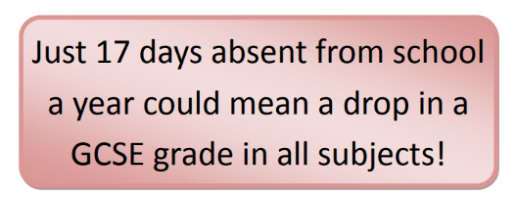
Attendance = Achievement
Year 11 pupils with near-perfect attendance are almost twice as likely to achieve grade 5 in English and Maths GCSE, compared to similar pupils attending 90-95% of the time. In other words, missing just 10 extra days a year reduces the likelihood of achieving these grades by around 50%.

Slide 16
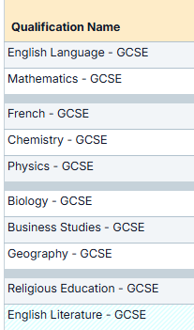

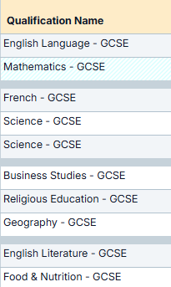

Attendance and Academic Achievement
Consider these two students of identical ability
Attendance = 84% Attendance = 98%

Slide 17
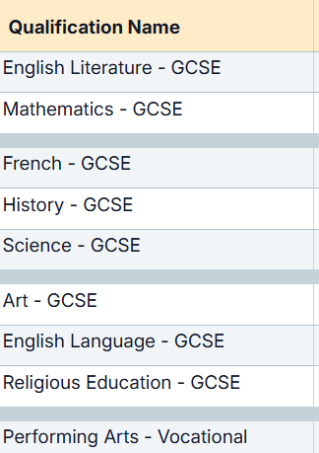

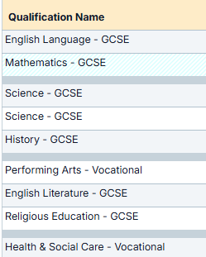

Attendance and Academic Achievement
Consider these two students of identical ability
Attendance = 89% Attendance = 99%

Slide 18
DfE guidance around mild illness and attendance remains
School attendance is vital to life chances
Health, wellbeing and socialisation
Post-pandemic there are more children whose absence may be due to symptoms of anxiety
Worry and mild or moderate anxiety can be a normal part of growing up for many children
This can increase in Y11 with pressure of examinations
Being in school can help alleviate the underlying issues
Prolonged periods of absence can heighten the anxiety

Slide 19
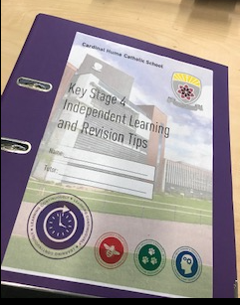
Organisation is key
All students will be given a revision folder like this one
It is essential that they keep on top of the
documentation and revision materials issued
They can use this to store homework tasks
and other independent study materials

Slide 20
Additional Support
Study Support (Mon, Wed, Thurs after school and every lunchtime)
Including two periods of ‘Extended Schooling’
Mentoring and the report system (YPL, Pastoral, SLT)
Small group tuition
Holiday sessions / additional revision sessions
Masterclasses
Pre-exam booster sessions
School Counsellor
Year Progress Leader – Mrs Covington

Slide 21
Y11 YPL – Mrs Covington
My priority as Year 11 Progress Leader:
How are pupils coping with the transition into Year 11 from year 10
How can we ensure all pupils are supported and making the progress they should?
Tutors – share workload and equipment concerns with YPL.
Teachers – log all concerns about work which is available to YPL.
HODs – ask their teams about concerns and share with YPL.
Overall A regular flow of information from tutors, staff and Heads of Department
will guide who I support and when.

Slide 22
Y11 YPL – Ongoing Support
The library is available to year 11 during their lunchtimes on Monday and Wednesdays to keep on top of homework and revision.
YPL led Study Space is available every Tuesday lunchtimes. 25 spaces will be available. I will invite some pupils who could benefit, it will be compulsory for some and voluntary for others.
Academic Mentoring will be available via a purple report as a more intensive support to help support progress and raise personal achievement. Support with grades, organisation and or punctuality.
Personal Development Opportunities
Bespoke mentoring and workshops from aspirational professionals from charity NCS
Workshops from local universities, including Durham and Newcastle University. Focusing on 'Future Me'

Slide 23
Life after Year 11 at Cardinal Hume
Cardinal Hume Sixth Form 2025
Almost 25% of all grades were A*-A
77% of all grades were A*-C
Many students from Y13 2025 have gone on to Russell Group Universities
5 students from the past two year groups are now studying at Oxford or Cambridge
Entry requirements and differing routes :
5 grade 4s or above for level 3 study, including English Language
Majority of grade 6 or above indicates suitability for A-level study
A mixture of grade 5 and 6 indicates A-level/vocational mix
Apprenticeship Pathway offers Level 3 study and Work Experience

Slide 24
Concluding comments
Year 11 will pass very quickly
Key dates – keep an eye out for examination periods
Support from home will be crucial
Importance of School and home giving the same messages

